Slide 1
Rutgers Advanced Addiction Treatment Center (RAATC)
Muhlenberg Regional Medical Center
Plainfield, NJ
Notes:
Thanks very much to Dr. Danielle Dick and the Rutgers Addiction Research Center for inviting me to speak today. I’m excited to share a program that UBHC has been working on for 3+ years.

Slide 2
Introducing RAATC
Notes:
Site of former Muhlenberg hospital; school of nursing. While this has been a multi-departmental effort within Rutgers, I’d like to thank Dr. Manny Guantez has overseen every aspect of this project and we are very grateful to him for his leadership and passion for this project.

Slide 3
Free Standing Addiction Treatment Center to include:
Medically Monitored Intensive Inpatient Services (ASAM Level 3.7 WM):
Medically Monitored Withdrawal Management for adults; 20 licensed beds
Short Term Residential (ASAM Level 3.7)
16 male beds; 8 female beds
Intensive Outpatient Services (ASAM Level 2.1)
Multiple tracks available to meet complex needs of individuals
Daytime, evening and weekend hours
Primary addiction and co-occurring disorders
Outpatient Services (ASAM Level 1):
Individual, group, family counseling

Slide 4
Strategic Initiative
UBHC historically has had a small footprint in SUD treatment space
Expansion has included additional licensed clinics, expansion of MAT, Ambulatory Withdrawal Management, Community Based Case Management and Peer Support programs.
Involvement in Interim Management Entity identified unmet treatment needs
The addition of RAATC will create SUD Service line to support state-wide continuum of care
Notes:
Frank Ghinassi- Strategic plan to increase footprint in SUD services.

Slide 5
Notes:
By County, number of individuals in a 12 month period who identified need and desire for treatment. Overall, 40% of individuals who reported the need for treatment di not receive the treatment. Adult population surveyed.

Slide 6
RAATC
Vision: To create a world-class substance use disorder treatment center informed by sound clinical services through advancement of evidence-based practices and cutting-edge treatments and research
Mission: To provide comprehensive, holistic and integrated diagnostic and clinical care to individuals and their families who are affected by substance use disorders and co-occurring disorders

Slide 7
Goals:
Create a comprehensive addictions treatment system in which we:
Recruit highly dedicated and clinically proficient staff
Create training program with a comprehensive supervision model
Participate in cutting edge clinical trials
Become a center of excellence that is outcome based and value-based driven
Richly infuse MAT and family work into treatment models
Provide internship/training opportunities for Rutgers students
Become site for Psychiatry Fellowship/Psychology Intern Programs

Slide 8
Core Tenets:
Individualized and Person-Centered Care that focused on building collaboration with individuals and families within a culture of acceptance and compassion
Culturally informed and flexible program that honors and respects the beliefs, languages, interpersonal styles and behaviors of individuals and families receiving services, as well as staff members
Comprehensive care model that address any associated medical, psychological, social, vocational and legal problems

Slide 9
Core Tenets Continued:
Trauma-Informed structure and treatment framework that involves understanding, recognizing and responding to the effects of all types of trauma by creating safe, collaborative and empowering environments
Outcomes based approach to ensure effectiveness and demonstrate quality of care to individuals and families
Research focus with efforts to infuse research and research training with a broad interdisciplinary perspective
Notes:
Dr. Guantez and I have already been in discussion with Dr. Dick and the Research Center on ensuring we are building an infrastructure for research from the very start of the Center’s operations.

Slide 10
Withdrawal Management/Residential Space
Notes:
Each unit has lounge/dining space. Rooms are light filled and spacious.

Slide 11
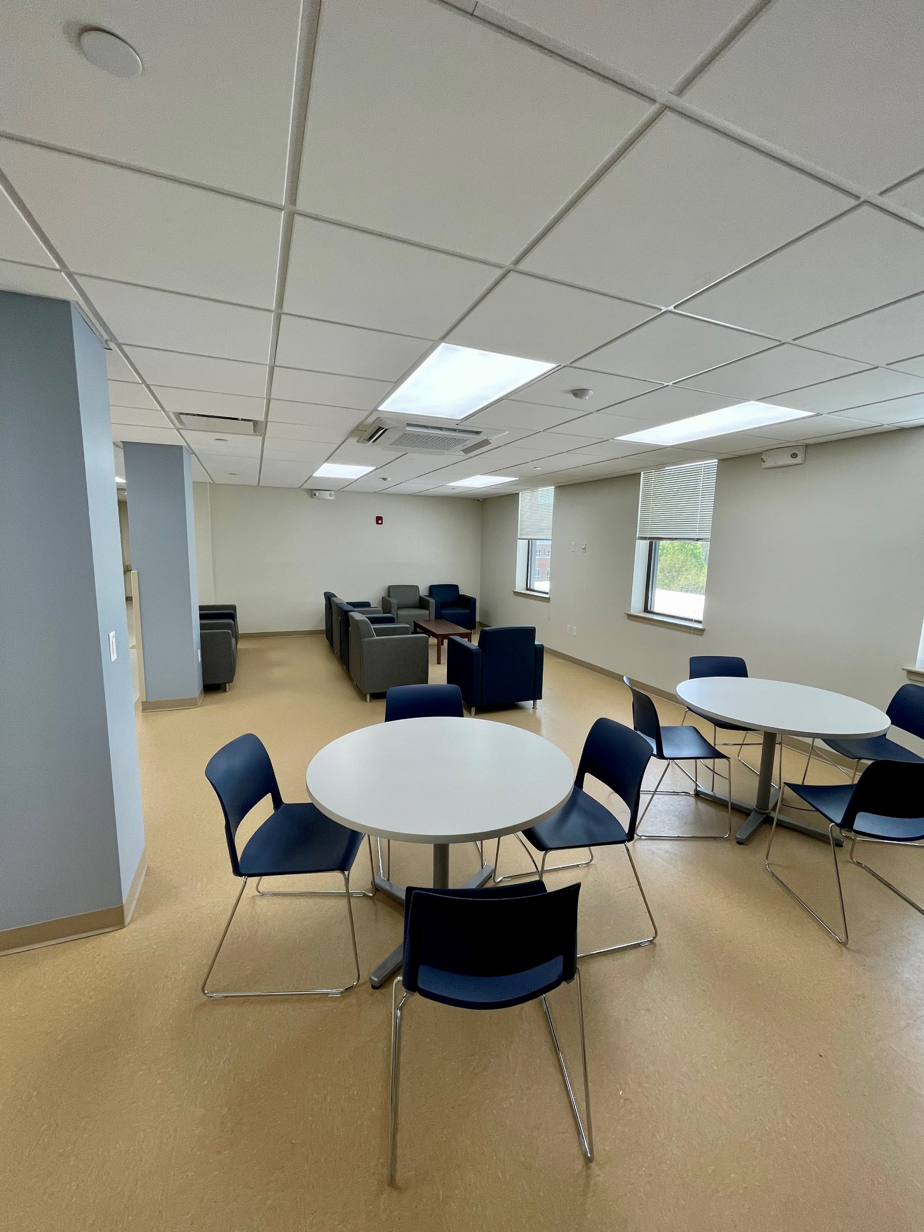
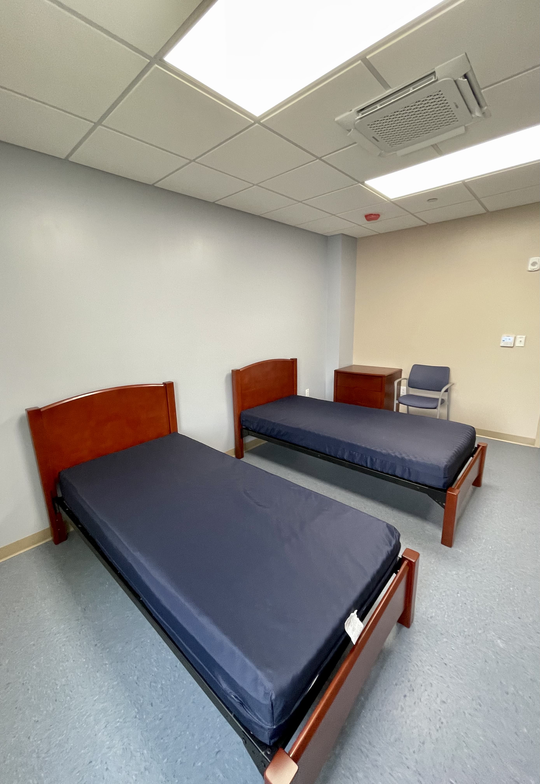
Notes:
Single and Double occupancy rooms with attached bathrooms. ADA Accessible. In process of selecting bedding/artwork to help make the environment comfortable.

Slide 12
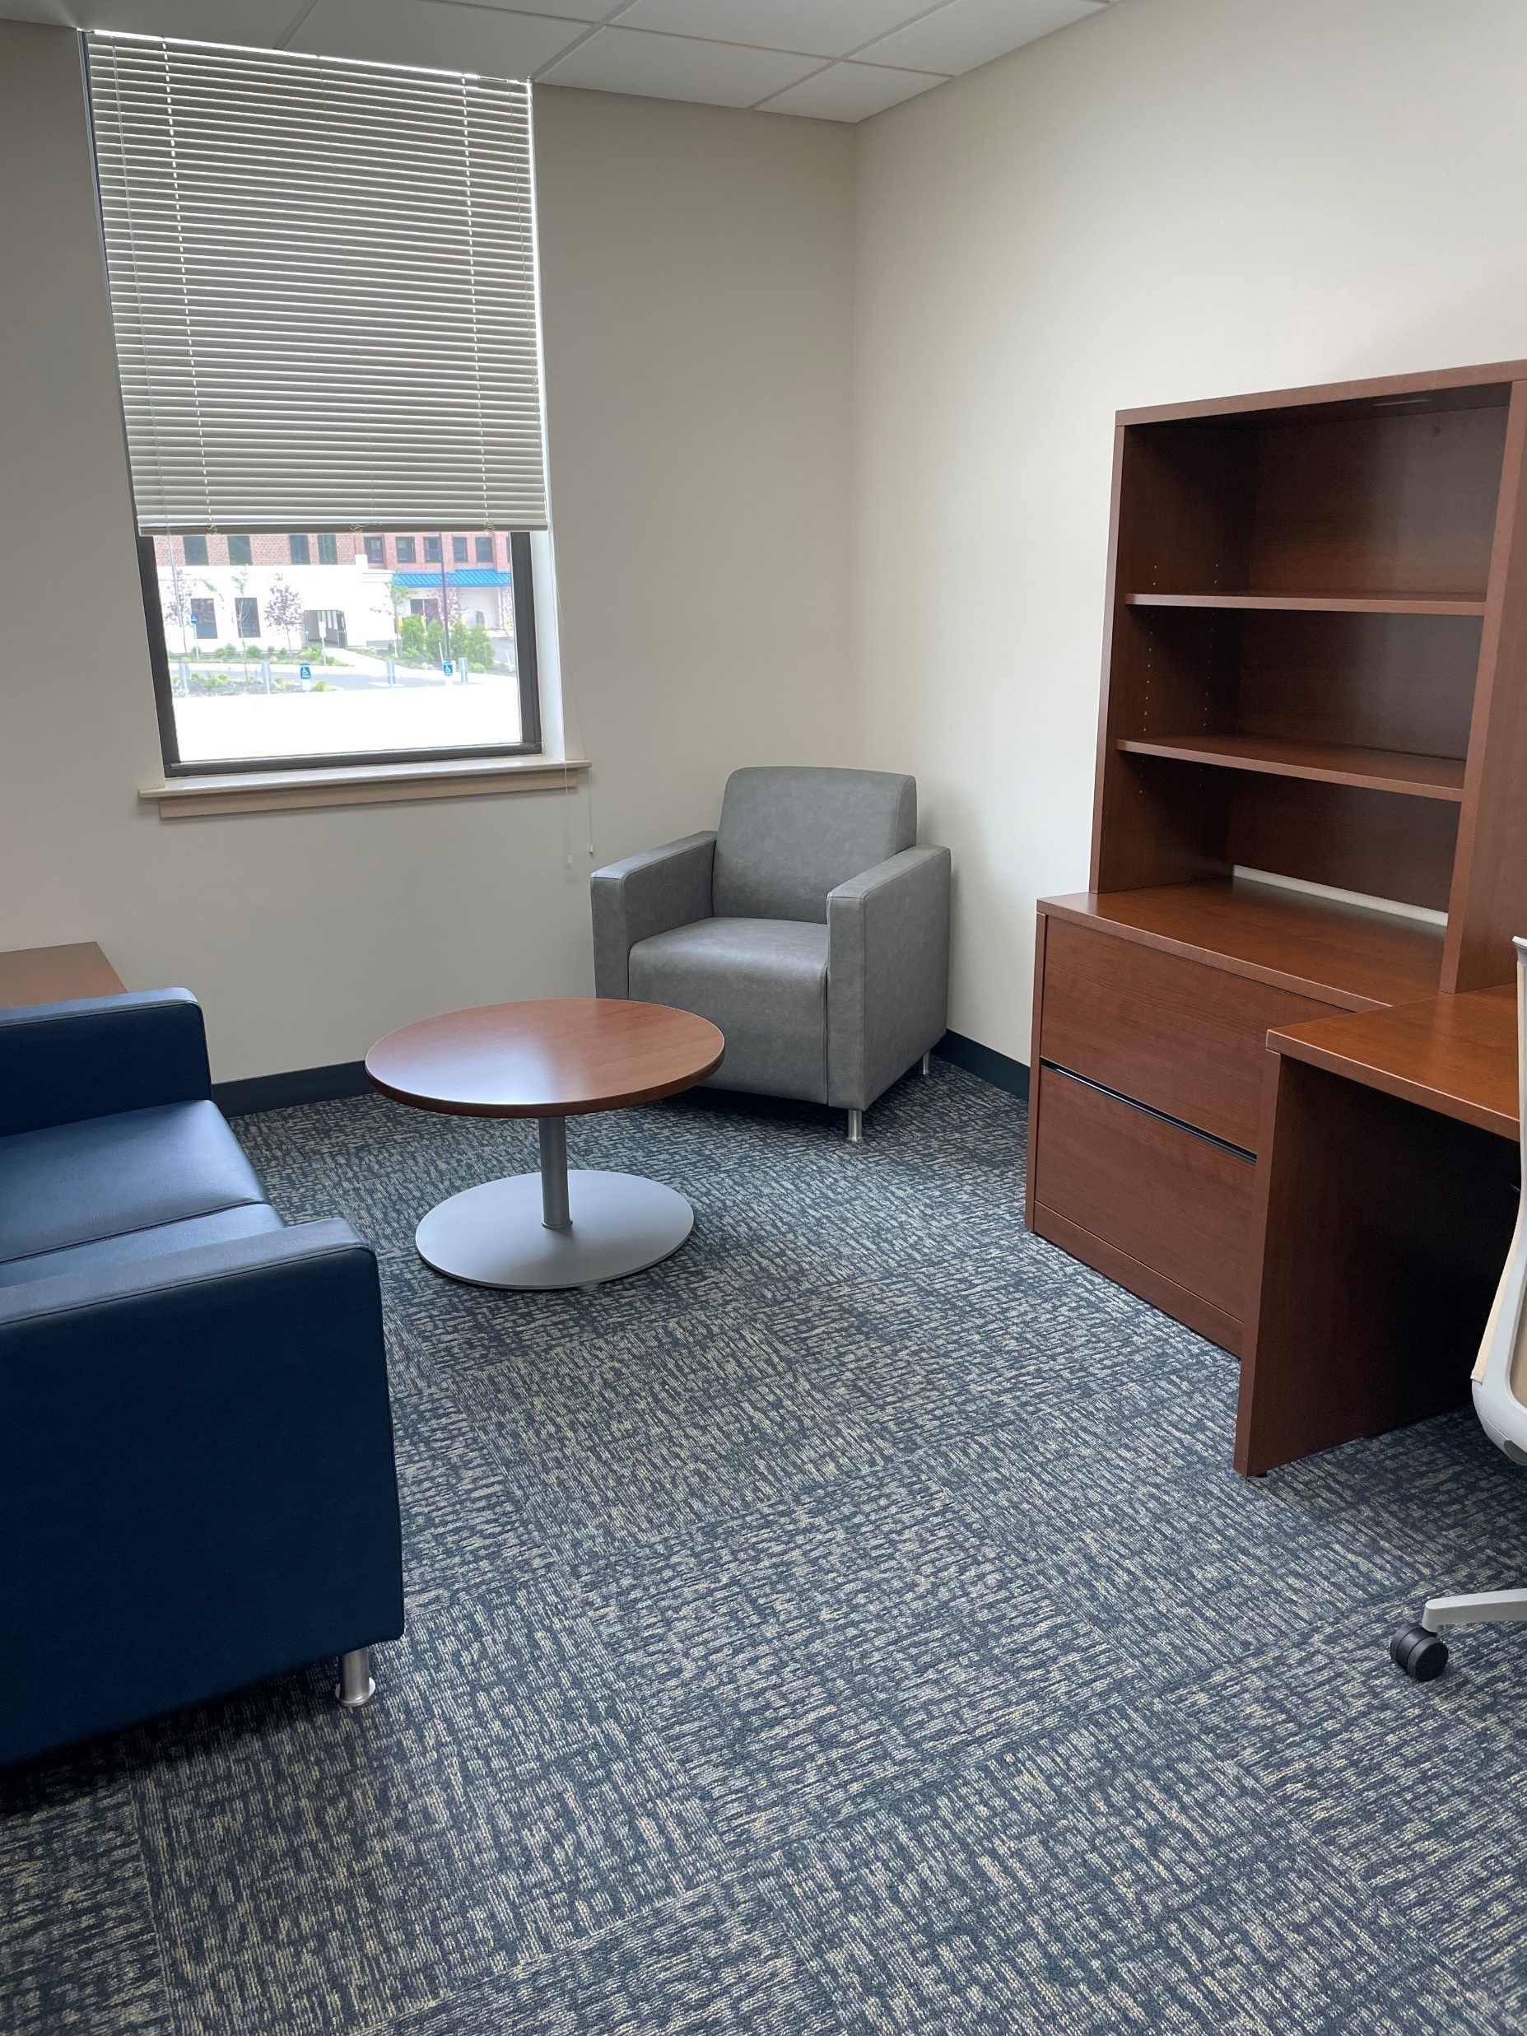
Treatment Space
Notes:
Offices are spacious, set up for individual and family sessions. Conference room is dual purpose as group room space. Smart TVs will be set up in group rooms for educational groups.

Slide 13
Wellness Focus
Notes:
Well equipped fitness room and separate yoga/meditation/mindfulness studio.

Slide 14
Outdoor Space
Notes:
Earlier photo of outdoor space. The area has been landscaped and lovely patio furniture is in place. That’s the tour; we feel it will be a very pleasant, comfortable facility for individuals and families to start their recovery journeys.

Slide 15
Triple Aim
Treatment
Training
Research
Notes:
In closing, we are very excited to launch what we believe will be a Center of Excellence for Substance Use Disorder Treatment, backed by Evidence Based Practices. One that trains the next generation of treatment providers and advances the science through Research..

Slide 16
For more information:
Mary-Catherine Bohan
mc.bohan@rutgers.edu
Manuel Guantez
Manuel.Guantez@ubhc.rutgers.edu

Slide 17
Questions?

